Slide 1
Profit margin drivers
Acme Corp.
August 4, 2019

Slide 2
Executive Summary
Baseline
Acme Corp.’s current retail portfolio includes 297 leased and 33 owned locations across 7 states in the US. Mean annual profit margin of a typical store is 24.8%
Margin driver: Location
Stores in Texas, California, Colorado, Washington and Illinois perform well with an average annual per-store profit margin of 26.4%. Stores in Georgia and New Jersey have been held to an average annual profit margin of 20.1%.
Margin driver: Product portfolio
Over the past 12 months, the 135 stores that carried >4550 products had an average margin of 29.1%. In contrast, the 198 stores with <4550 products had an average margin of 21.9%.
Location strategy opportunity
Colorado offers untapped opportunity for future business growth. It’s the 3rd highest state in terms of average profit margin (25.4%) but has the second smallest store footprint with only 15 stores.
Product portfolio opportunity
Performance of low margin stores in NJ, GA can be improved by introducing more high margin products in stores with <4550 products. These stores have a margin of 16.9%, while stores with >4550 products have a margin of 25.1% on avg.
Opportunity enablement
The next step to boost margins will be to conduct a deep dive into the product portfolio of high margin stores and understand how it currently differs from low margin stores within a state.

Slide 3
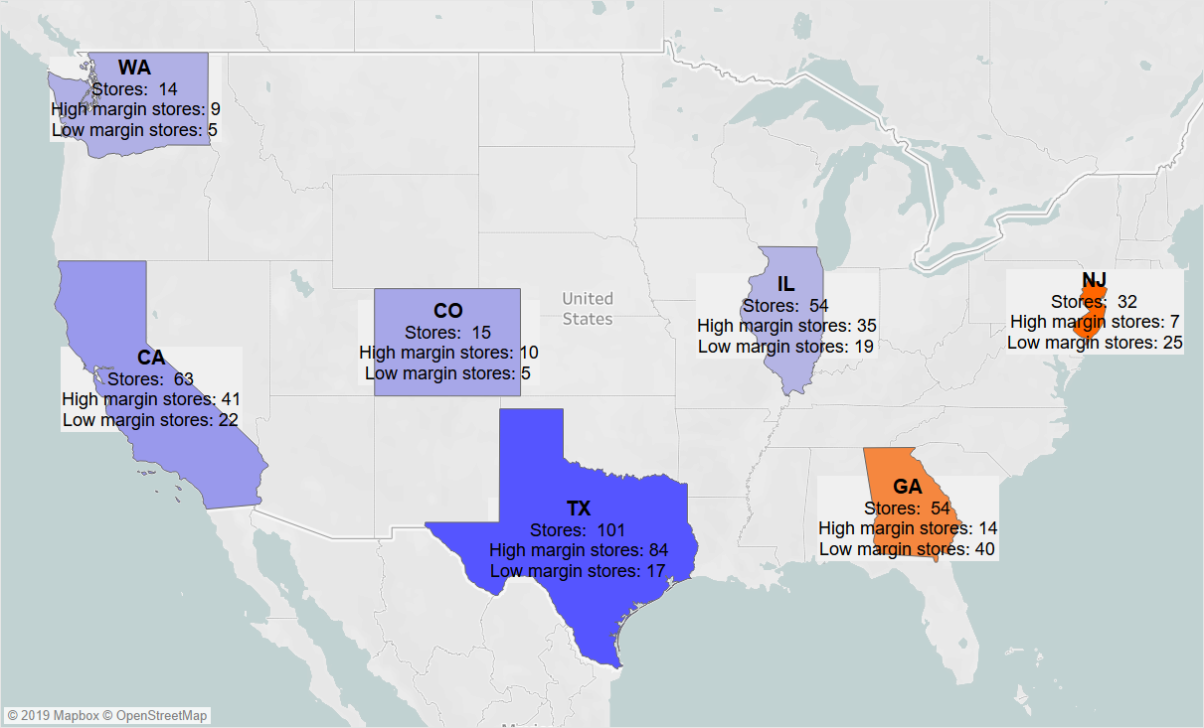
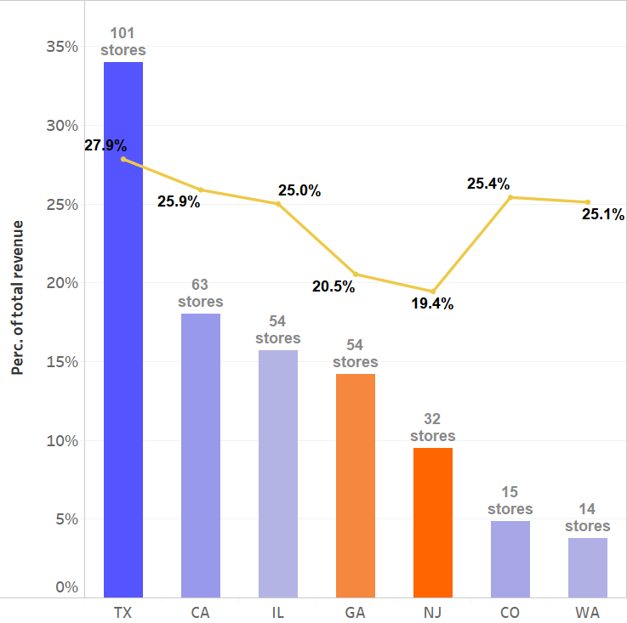

TX stores have been outperforming stores in other states with a 27.9% profit margin across 101 stores. NJ and GA have highest no. of low margin* stores
Location of retail sites
1
2
3
1
TX and CA contain the largest percentage of stores in our portfolio and these stores are performing well on aggregate.
Among the low margin stores in NJ and GA, not all stores perform poorly. Since 7 stores in NJ and 14 stores in GA have margins greater than the national average, it suggests that other stores in the state have an opportunity to improve margins by emulating the behavior of higher margin stores in their state.
2
NJ and GA have a high number of stores, leading to them comprising a significant chunk of total gross revenue. However, the profit margin on this revenue is under par when compared to states like TX with a higher number of stores and also when compared to states like CO with a smaller number of stores.
3
As our business looks to expand, there is untapped opportunity in CO, as it has our second smallest footprint even though its among the top 3 best performing states based on margin.
* Low margin: Stores with margin under 24.8% (mean margin across all stores).

Slide 4
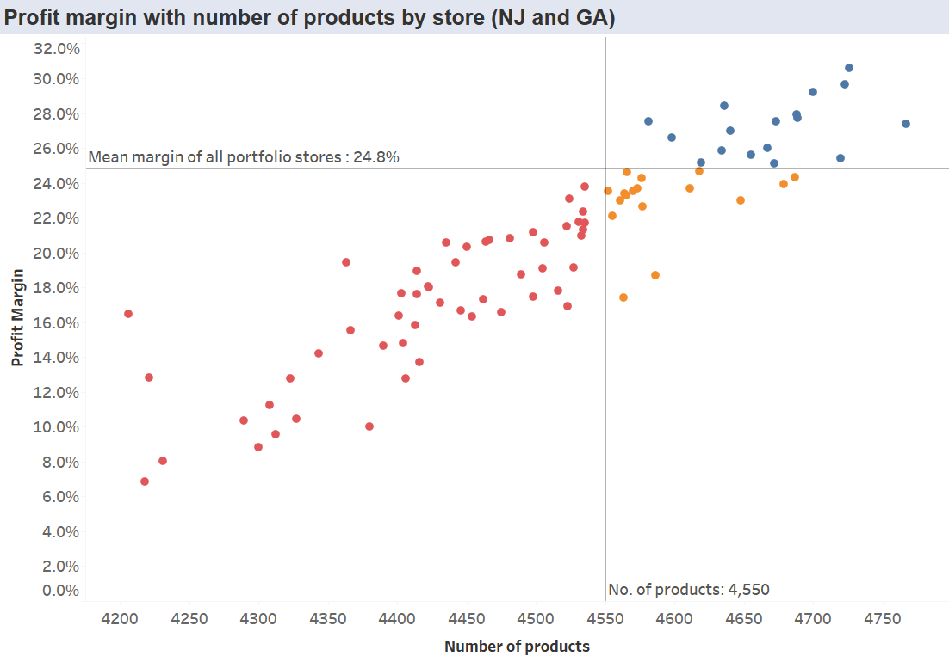

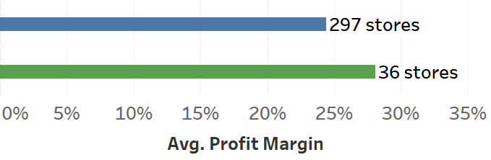
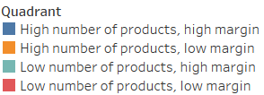
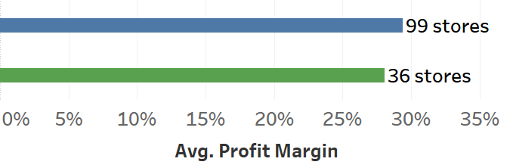
Within NJ and GA, not all stores have poor margins. Margins for low performing stores can be improved by optimizing the product mix offered.
Product mix and number of products carried
1
3
3
At first glance, the rent-adjusted profit margin of owned stores seems to be higher than the profit margin of leased stores. However, this is because all 36 owned stores carry a high number of products. Compared only to the leased stores that carry >4550 products, margins for leased stores are found to be higher than owned stores.
1
Within NJ and GA, not all stores perform poorly on profit margin. Stores that carry a higher number of products (> 4550) have a higher margin than stores with <4500 products.
2
No. of products | No. of stores | Avg. profit margin | Avg. total cost | Avg. gross revenue
<4,550 | 52 | 16.9% | $ 217 M | $ 264 M
>4,550 | 34 | 25.1% | $ 324 M | $ 434 M
2
There is opportunity to boost the margin of the 52 stores in the bottom left quadrant by 1) analyzing the product mix of the top right quadrant stores and identifying high margin products 2) introducing these products in the bottom left quadrant stores. With this approach the average profit margin of 16.9% for these low margin stores can be bought up significantly closer to the 25.1% margin of the top right quadrant stores.

